Slide 1
Problem ：multi-goal path planning
(multi-task allocation and path planning )
The multi-goal path planning aims to search a collision-free path for visiting a sequence of goals with the minimized total route.
TSP: in multi-goal path planning based on grid map, the cost of any two nodes is unknown before robot moving, which is different from the traditional Traveling Salesman Problem.
The local optimal path (path planning) and the global optimal goal sequence (TSP)
Structure: a high-level task allocation scheme and a low-level path planning scheme. A sophisticated task allocation algorithm is first used to calculate an optimal task execution sequence, and then the path planning algorithm is used to generate collision free trajectories visiting each goal point by following the sequence.

Slide 2
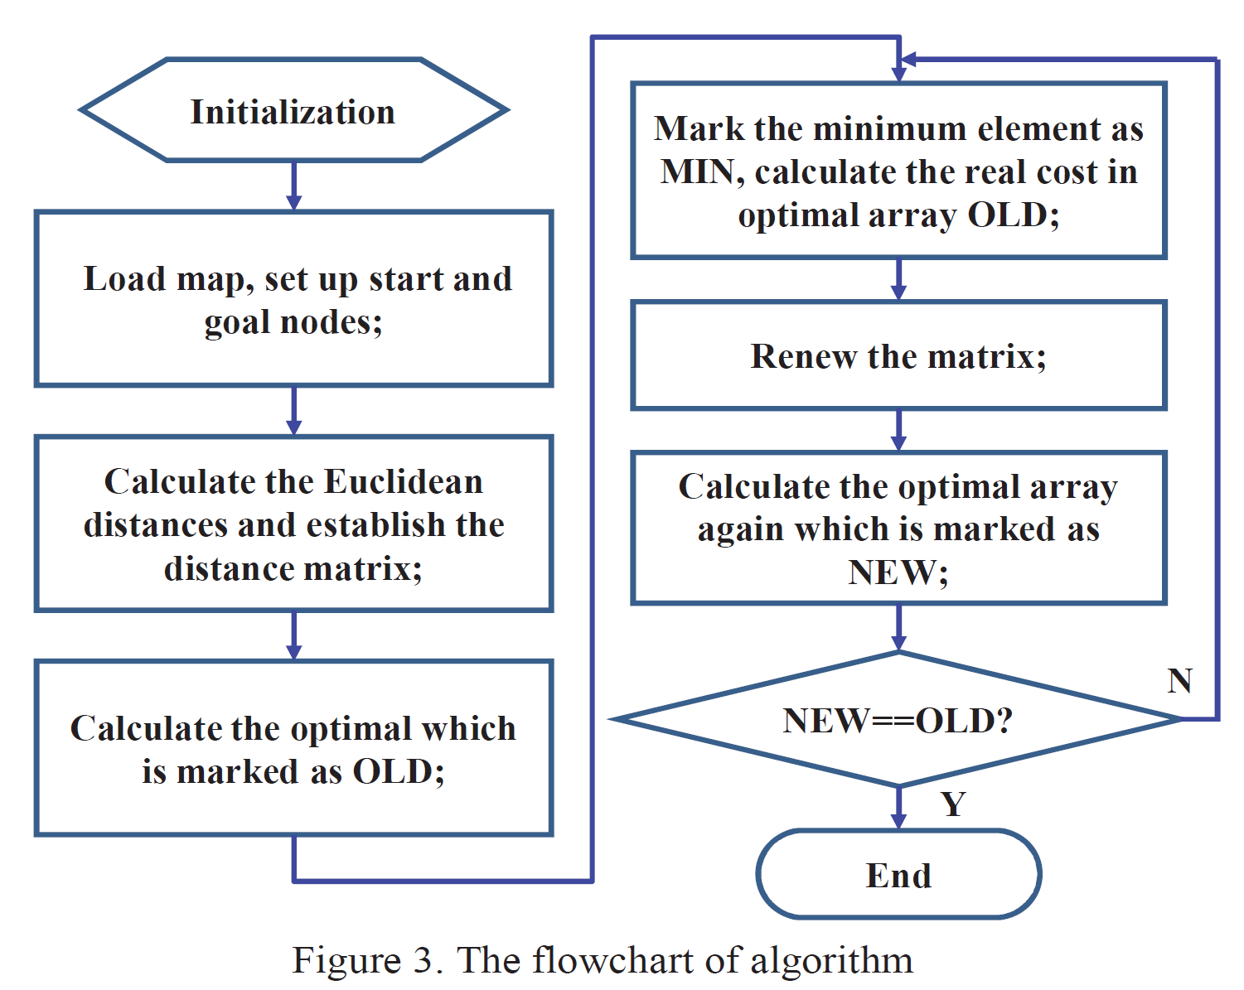
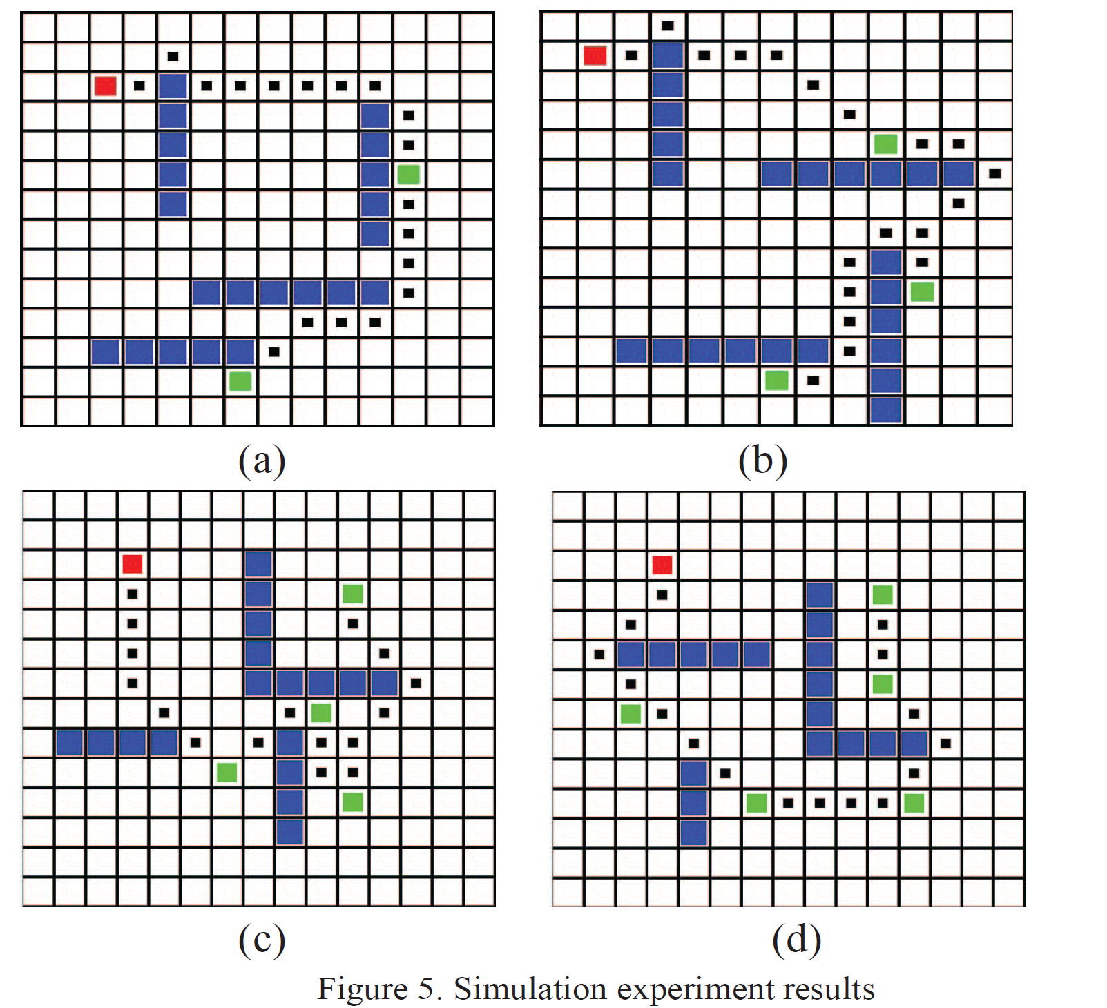
Idea 1:
Hongyun L, Xiao J, Hehua J. Multi-goal path planning algorithm for mobile robots in grid space[C]//2013 25th Chinese Control and Decision Conference (CCDC). IEEE, 2013: 2872-2876.
Real cost by path planning
(branch-detected)
Update the distance matrix
Re-calculate the tsp
TSP by goals’ Euclidean distances
(A* Heuristic)
Temporary task optimal sequence
Pros and cons:
Real-time …
Path planning …

Slide 3
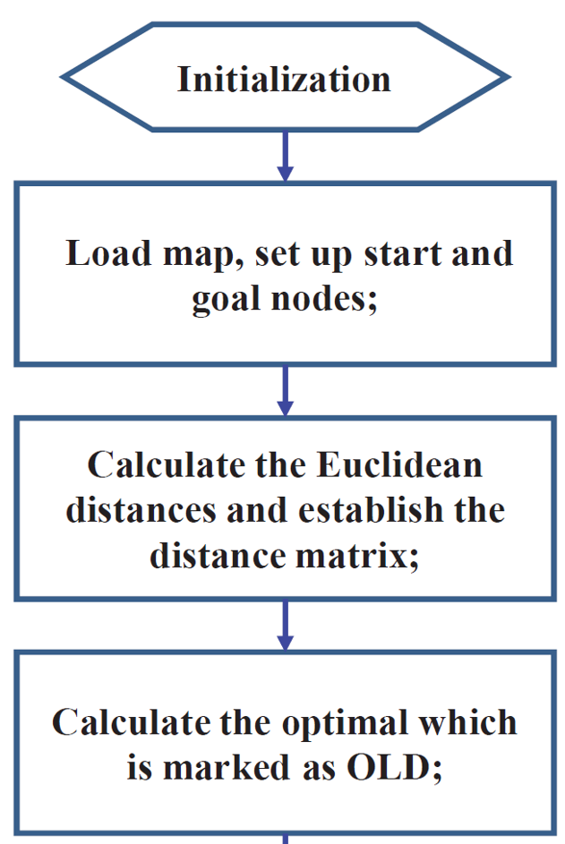
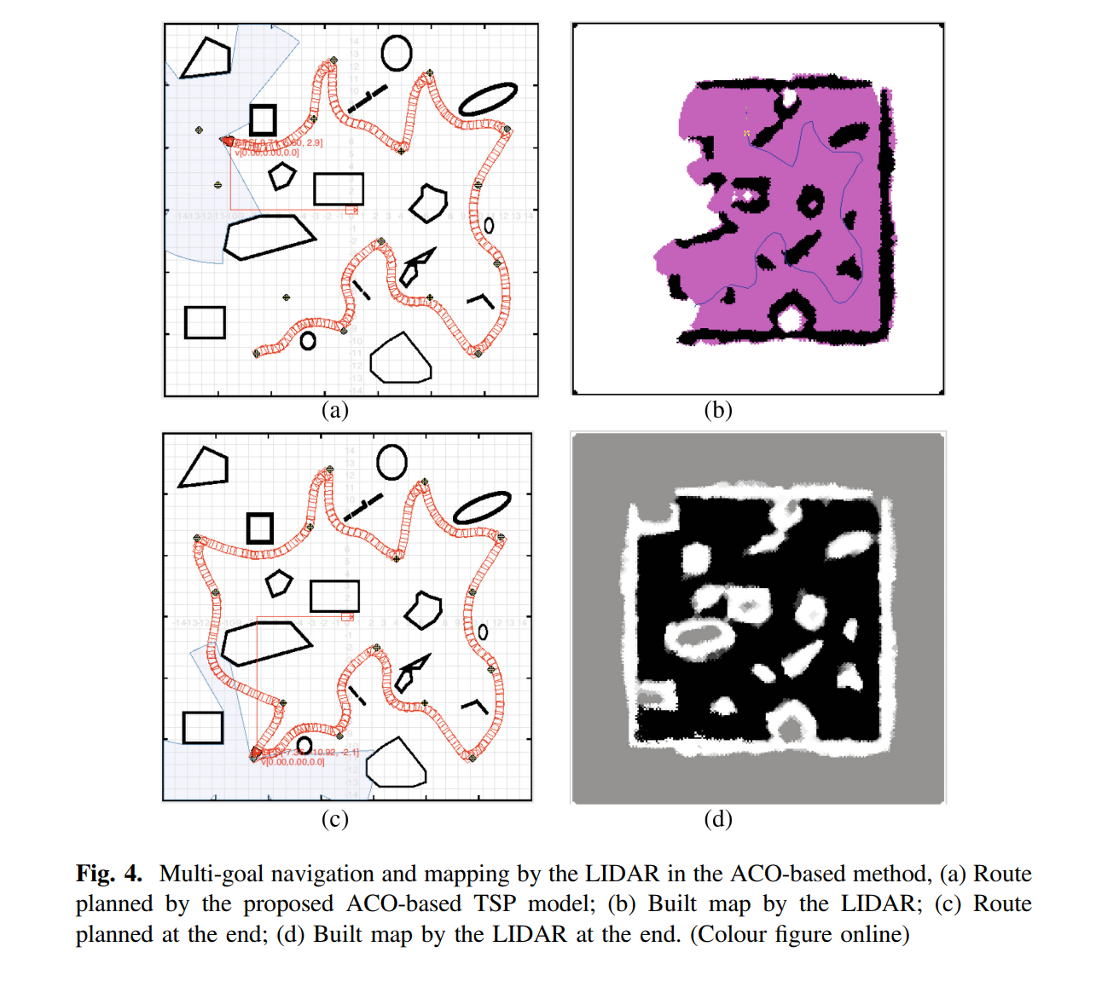
Idea 2:
Luo C, Mo H, Shen F, et al. Multi-goal motion planning of an autonomous robot in unknown environments by an ant colony optimization approach[C]//International Conference on Swarm Intelligence. Springer, Cham, 2016: 519-527.
TSP by goals’
Euclidean distances
(Ant colony optimization)
Task optimal sequence
Goal-goal by path planning
Global (D*-Lite)
local (Vector Field Histogram)
Pros and cons:
Real-time …
Real world application…
Path

Slide 4
Idea 3:
Liu Y, Bucknall R. Efficient multi-task allocation and path planning for unmanned surface vehicle in support of ocean operations[J]. Neurocomputing, 2018, 275: 1550-1566.

